Slide 1

Introduction to IoT and Smart Systems
Presented by :
Balaji . K Subject: Software Engineering
192511404 Subject code: CSA1017
SAVEETHA SCHOOL OF ENGINEERING

Slide 2

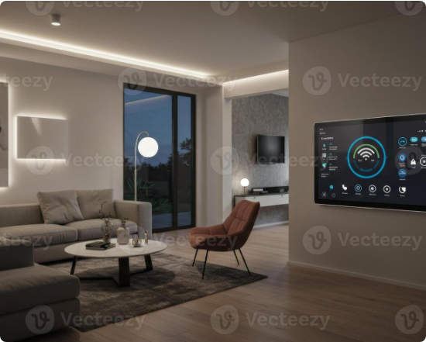
1. Introduction to IoT and Smart Systems
Vast network of physical objects embedded with smart sensors.
Connects devices to seamlessly exchange data over the internet.
Bridges the gap between the physical and digital worlds perfectly.
Transforms ordinary everyday items into highly intelligent assets.
Enables autonomous decision-making in real-time environments.
SAVEETHA SCHOOL OF ENGINEERING

Slide 3
2. Need and Motivation
Exponential global demand for industrial automation and efficiency.
Absolute necessity for real-time monitoring and data analytics.
Strong desire to reduce human intervention in routine daily tasks.
Critical push for optimized global resource and energy management.
Enhancing overall quality of human life through smart conveniences.
SAVEETHA SCHOOL OF ENGINEERING

Slide 4
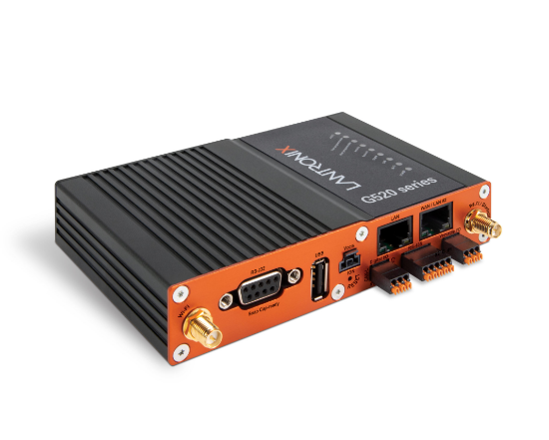
3. Working Principle & Architecture
Sensors continuously collect raw data from the surrounding environment.
Connectivity layers transmit this data securely to cloud platforms.
Data processing engines analyze incoming information instantly.
User interfaces provide actionable insights and remote controls.
Actuators execute physical actions strictly based on system commands.
SAVEETHA SCHOOL OF ENGINEERING

Slide 5
4. Key Components and Technologies
Advanced precision sensors and responsive physical actuation devices.
Highly reliable connectivity protocols including Wi-Fi, Bluetooth, and 5G.
Secure cloud computing and localized edge processing infrastructure.
Machine learning algorithms strictly tailored for predictive data analytics.
Intuitive user dashboards and cross-platform mobile applications.
SAVEETHA SCHOOL OF ENGINEERING

Slide 6
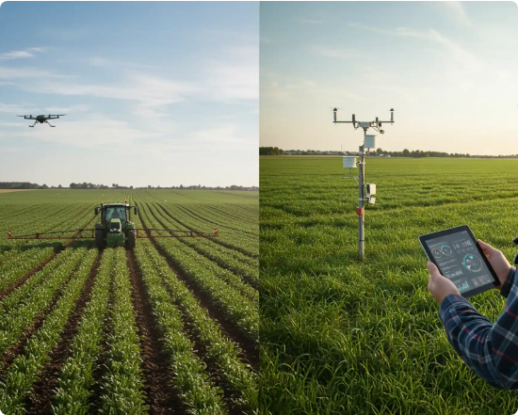
5. Applications & Real-World Use Cases
Smart homes flawlessly optimizing lighting, security, and climate.
Wearable health monitors proactively tracking patient vital signs.
Industrial IoT actively enabling predictive factory maintenance.
Smart agriculture utilizing precision soil moisture sensing networks.
Connected smart cities dynamically managing traffic and public resources.
SAVEETHA SCHOOL OF ENGINEERING

Slide 7
6. Advantages and Limitations
Key Advantages
Major Limitations
Drastically increases operational efficiency and overall productivity.
Presents significant security and sensitive data privacy vulnerabilities.
Enables data-driven, precise, and instantaneous decision-making.
Exhibits an absolute dependency on continuous internet connectivity.
Significantly reduces long-term operational costs and manual labor.
Faces high complexity in standardizing diverse hardware protocols.
SAVEETHA SCHOOL OF ENGINEERING

Slide 8
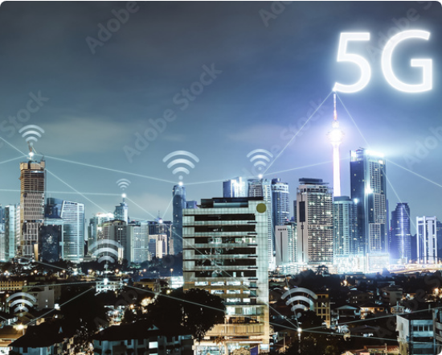
7. Recent Developments and Trends
Seamless integration of Artificial Intelligence (AIoT) for autonomy.
Rapid rise of Edge computing to drastically reduce network latency.
Massive expansion of 5G networks enhancing data transmission speed.
Accelerated adoption of Digital Twins for virtual system simulation.
Implementation of secure blockchain for decentralized IoT transactions.
SAVEETHA SCHOOL OF ENGINEERING

Slide 9
8. Challenges and Future Scope
Mitigating increasingly severe cyberattack risks on connected edge devices.
Structuring and managing the massive volumes of generated big data.
Establishing universal interoperability standards across rival manufacturers.
Expanding robust IoT capabilities into remote and underserved geographic areas.
Developing highly energy-efficient and completely self-powering sensors.
SAVEETHA SCHOOL OF ENGINEERING

Slide 10
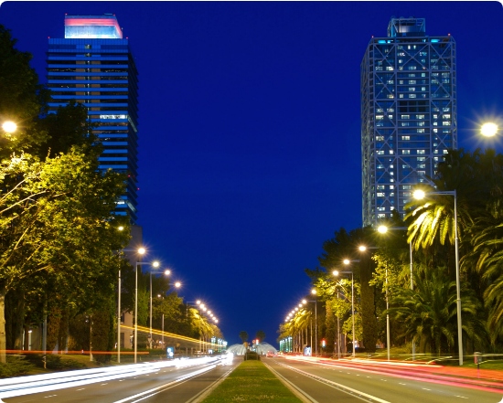
9. Case Study: Smart City Barcelona
Deployed thousands of smart sensors across all urban infrastructure.
Implemented intelligent street lighting to save massive energy costs.
Utilized smart parking networks to successfully reduce traffic congestion.
Continuously monitored environmental data for improved public health.
Saved millions annually while vastly enhancing general citizen services.
SAVEETHA SCHOOL OF ENGINEERING

Slide 11
10. Conclusion and References
IoT fundamentally and permanently redefines human technological interaction.
Unlocks completely unprecedented levels of convenience and industrial efficiency.
Security and strict standardization remain the most critical hurdles today.
Reference: IEEE Internet of Things Journal published annual research papers.
Reference: Global Smart City Implementation and Sustainability Reports (2025).
SAVEETHA SCHOOL OF ENGINEERING

Slide 12





Image Sources
https://static.vecteezy.com/system/resources/previews/071/531/383/non_2x/smart-home-automation-system-control-panel-in-modern-living-room-interior-design-technology-concept-photo.jpeg
Source: www.vecteezy.com
https://cdn.lantronix.com/wp-content/uploads/img/1657_G520_Top_Front_Right-scaled.jpg
Source: www.lantronix.com
https://www.cropin.com/wp-content/uploads/2024/11/Smart-Farming-vs.-Precision-Agriculture.webp
Source: www.cropin.com
https://as1.ftcdn.net/v2/jpg/01/83/89/90/1000_F_183899060_NL5JKb4nKHDWR7VDCbKVlYvdmn1AieKv.jpg
Source: www.ukposters.co.uk
https://www.lonmark.org/wp-content/uploads/2020/02/Barcelona-Towers-144220973_3424x2284-scaled.jpeg
Source: www.lonmark.org

